Slide 1
Programming Paradigms
“Programming is the art of telling another human being what one wants the computer to do.”
-Donald Knuth
CS 3022 – Introduction Continued
Notes:
Many of these slides were adapted from a course given by Stephen Schulz.

Slide 2
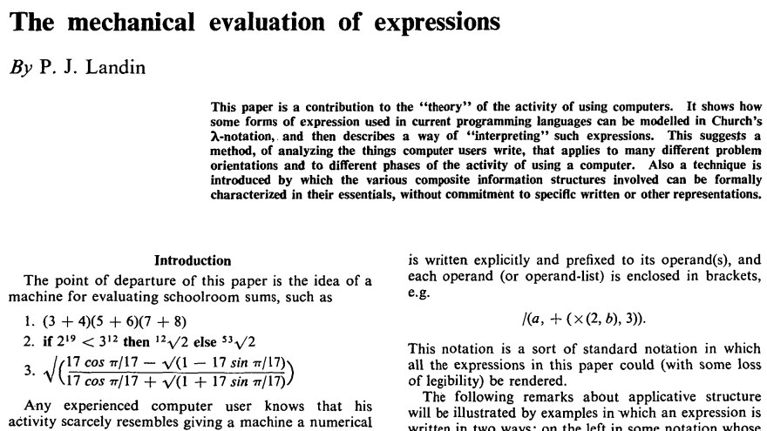
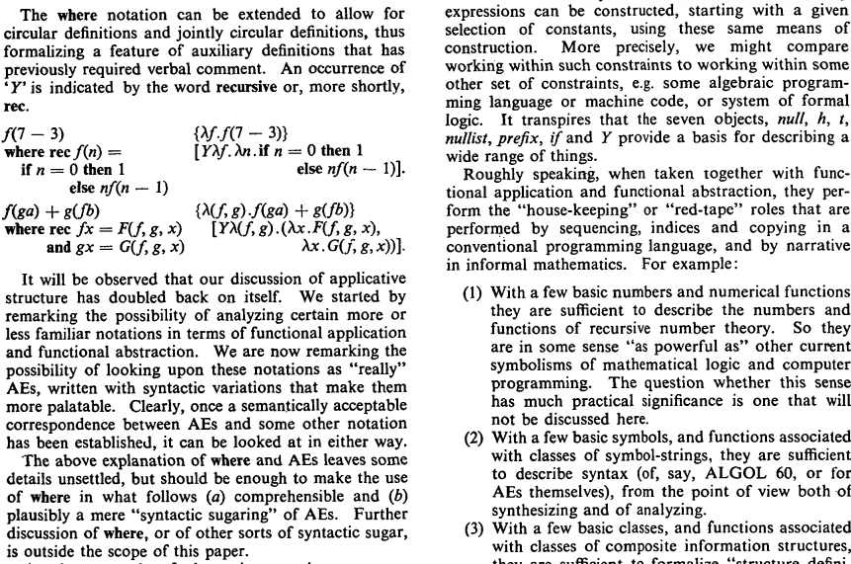



Syntactic sugar – P.J. Landin, 1968
Definition: Syntax that makes code easier to read or express

Slide 3
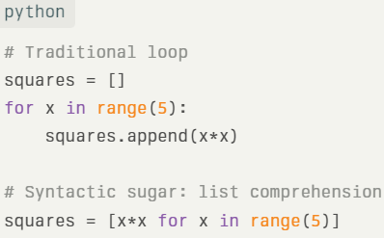
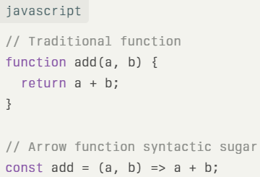
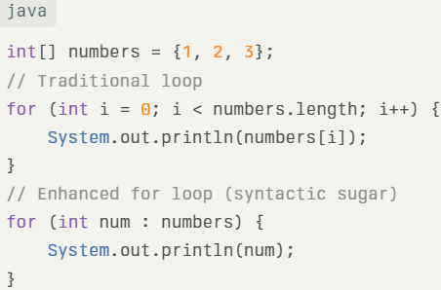
Examples of syntactic sugar
1. Python - List Comprehensions
2. JavaScript - Arrow Functions
3. Java - Enhanced For Loop (For-each)

Slide 4
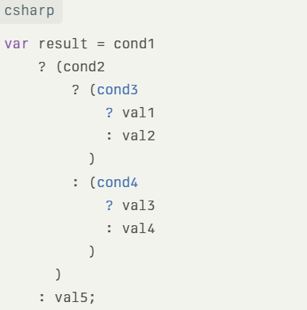
Syntactic diabetes

Slide 5
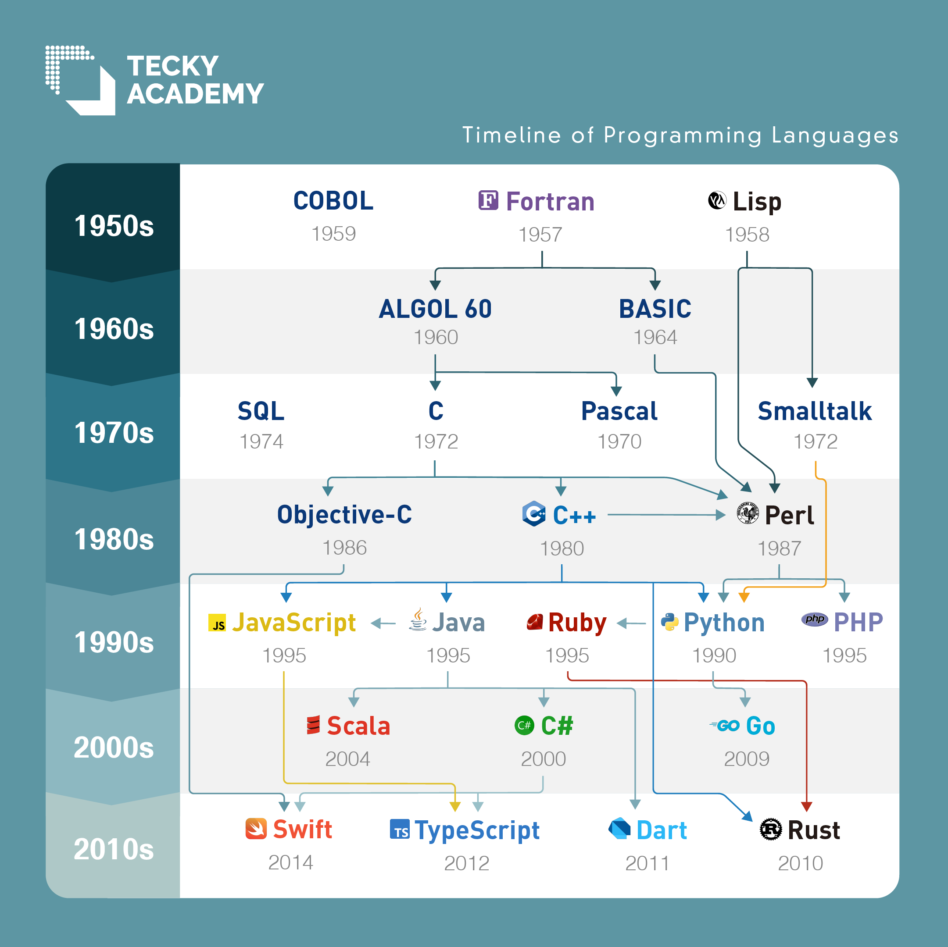
Evolution
* 50s-60s – Readable
* 60s-70s – Structured
* 70s-90s – Object Oriented
* 90s-00s – Web, VMs
* 00s-now – Safety, Vibes

Slide 6

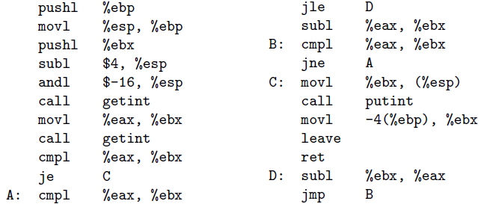
Is this syntactic sugar?
Euclid’s algorithm
Machine Language
Assembly Language

Slide 7
Assembly to Fortran
“Fortran was slow to catch on at first, because human programmers, with some effort, could almost always write assembly language programs that would run faster than what a compiler could produce. Over time, however, the performance gap has narrowed, and eventually reversed.”
- Programming Language Pragmatics, page 6

Slide 8
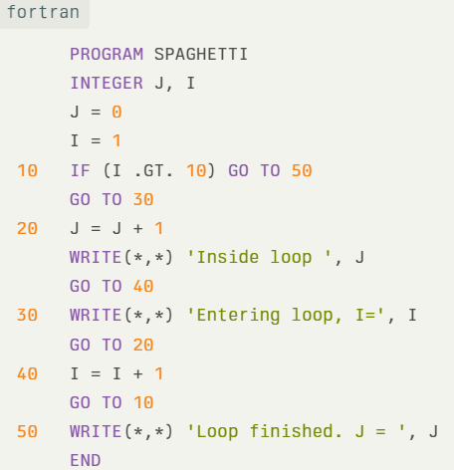
Spaghetti code

Slide 9
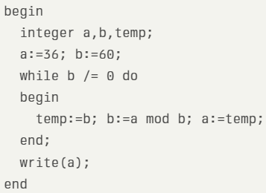
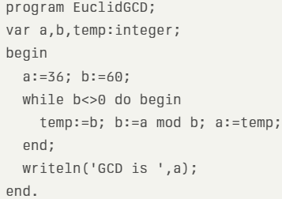
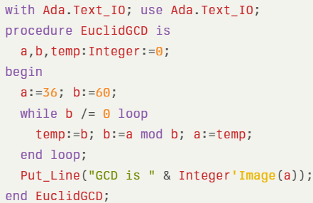
Structured Programming Revolution
“The late 1960s and early 1970s saw a revolution in ‘structured programming,’ in which the goto-based control flow of languages like Fortran, Cobol, and Basic3 gave way to while loops, case (switch) statements, and similar higher-level constructs.”
Algol
Pascal
Ada

Slide 10
Simula 67 – Most influential language you never heard of
Classes and Objects: Introduced the concept of defining classes and creating instances (objects) from those classes.
Inheritance: Allowed classes to inherit properties and behavior from other classes (subclasses).
Virtual Procedures (Dynamic Binding): Supported polymorphism through virtual methods that could be overridden.
Coroutines: Enabled cooperative multitasking and quasi-parallel execution by allowing multiple processes with their own stack (multi-stack language).
Garbage Collection: Automatic memory management to reclaim unused objects.
Subtyping: Introduced forms of subtyping beyond inheritance.
Block Structure and Prefixing: Allowed classes to be nested and for member visibility using "block prefixing."
Early Object-Oriented Paradigm: Simula combined procedural and object-oriented concepts, setting the stage for modern OO languages.

Slide 11
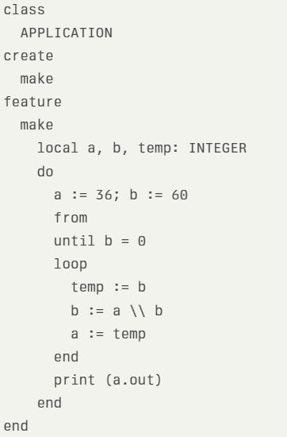
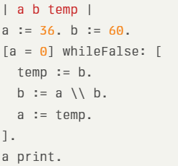
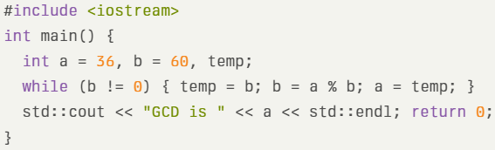
Object oriented
“In the late 1980s the nested block structure of languages like Algol, Pascal, and Ada began to give way to the object-oriented structure of Smalltalk, C++, Eiffel, and the like.”
Eiffel
Smalltalk
C++

Slide 12
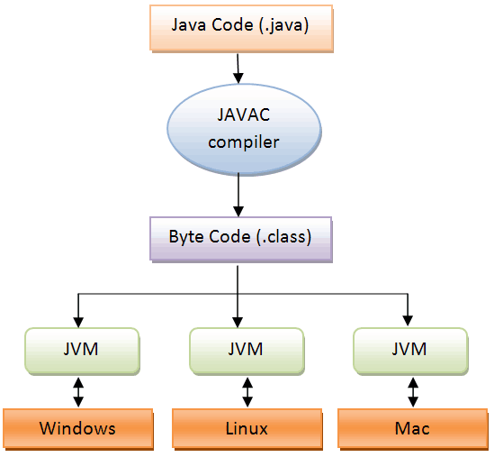
Rise of the Virtual machines – 1990-2000
Python Virtual Machine (1989)
Java Virtual Machine (1995)
Common Language Runtime (.NET, 2002)
LLVM (Low Level Virtual Machine*) (2000)
Are browsers a virtual machine?
* Not a real virtual machine

Slide 13
Modern trends: 2010 - 2025
* Memory safety
* Killing Null pointers
* Catching data race conditions at compile time
* Vibe coding, is it good?

Slide 14
Why so many languages?
Evolution: Programming languages evolved from structured programming in the 1960s-70s (e.g., replacing goto with loops and case statements) to object-oriented designs in the 1980s (e.g., Smalltalk, C++, Eiffel).
Special Purposes: Many languages were created for specific tasks—Lisp for symbolic data, Icon and Awk for string manipulation, C for low-level systems, and Prolog for logical reasoning.
Personal Preference: Language choice is often driven by individual taste, such as preferences for terse syntax, recursion vs. iteration, or pointer handling, making a universally accepted programming language unlikely.

Slide 15
What makes a language successful?
Expressive Power: Programming languages, though all Turing complete, differ greatly in how their features enable writing clear, concise, and maintainable code, especially in large systems, with abstraction being a key factor.
Ease of Use for Novices: Languages with a low learning curve, like Basic, Logo, Pascal, and more recently Java, gain success by being accessible and straightforward for beginners to learn.
Ease of Implementation: Languages that can be implemented efficiently on limited hardware, such as Basic and Forth, tend to spread more easily. Free and portable implementations, like Pascal’s and Java’s, have also boosted language adoption.
Standardization: Widely used languages often have official standards or a canonical implementation ensuring portability and consistency across platforms. Lack of standard features can lead to decline in popularity, as seen with Pascal.

Slide 16
What makes a language successful?
Open Source: Open-source compilers or interpreters help languages gain traction, with C being a prime example due to its close association with Unix and Linux, fostering wide adoption because of community support and portability.
Excellent Compilers: High-quality compilers, such as those for Fortran, contribute significantly to a language’s success by generating efficient code, especially for performance-critical applications.
Economics, Patronage, and Inertia: Non-technical factors like corporate or government backing, and the inertia of existing codebases and expertise, play large roles in a language's continued use and success, regardless of technical merits.

Slide 17
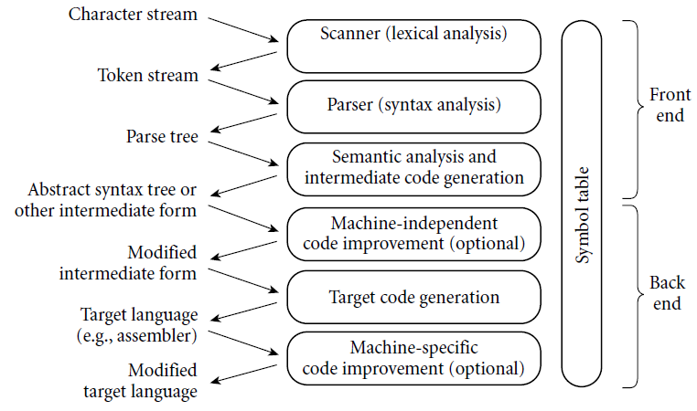
Phases of compilation

Slide 18
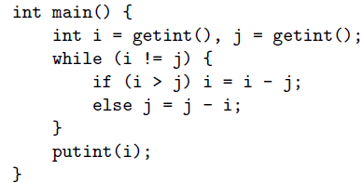
Euclid in C – compilation example

Slide 19
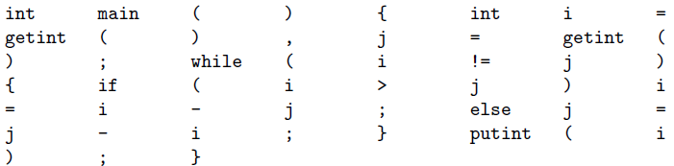
Scanner – Lexical Anaylisis
Tokens are the smallest meaningful units of the program.

Slide 20
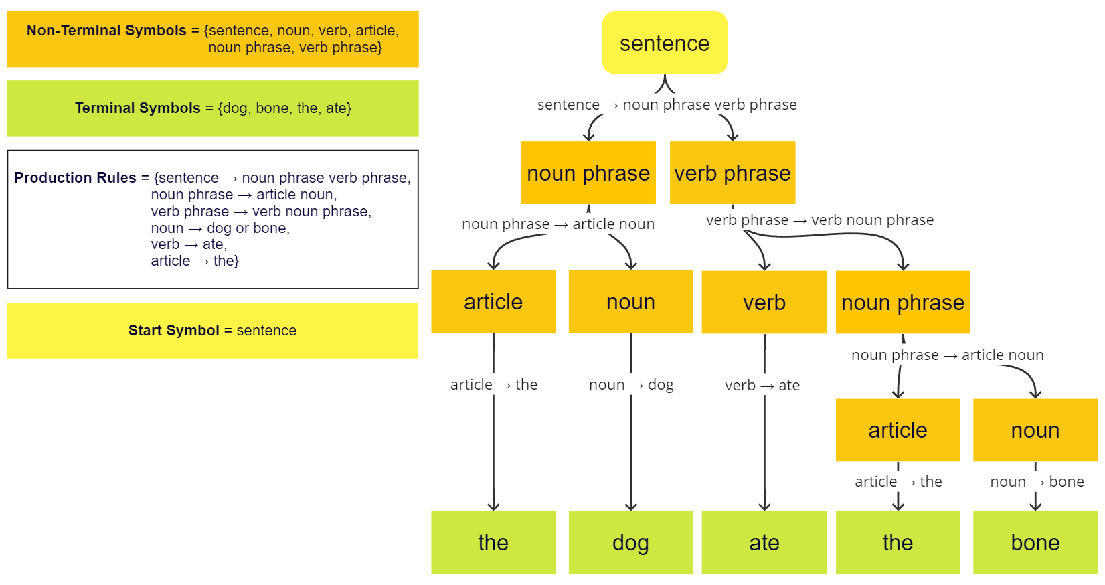
syntax trees

Slide 21
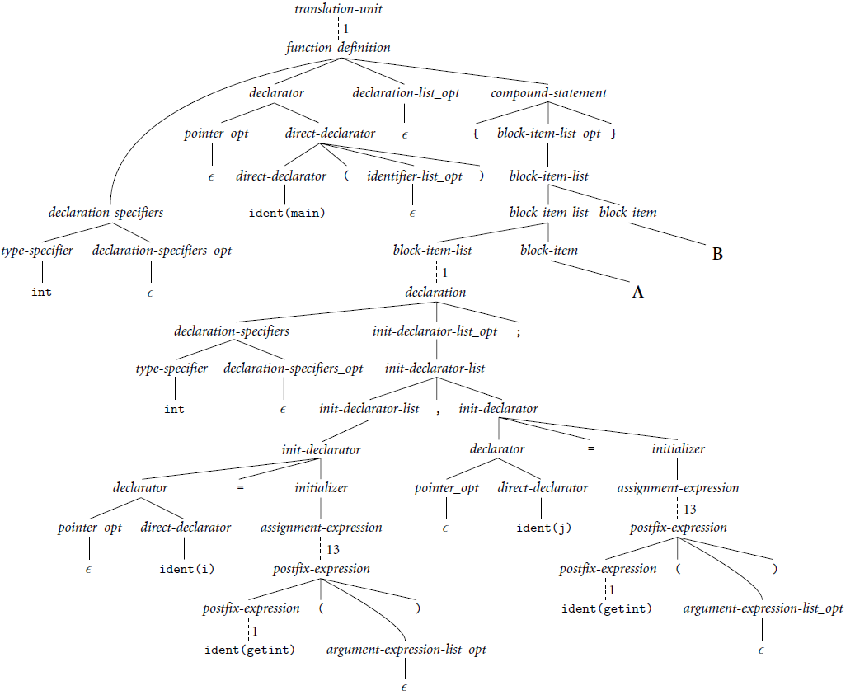
Parser - Parse tree (concrete syntax tree)

Slide 22
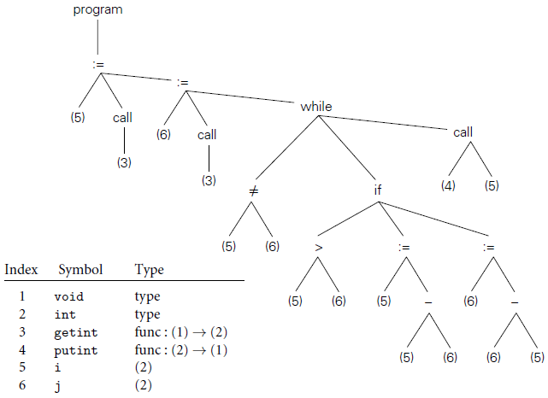
Semantic analyzer - Abstract syntax tree
Examples of semantic rules that might be checked:
Every identifier is declared before it is used.
No identifier is used in an inappropriate context (calling an integer as a subroutine, adding a string to an integer, referencing a field of the wrong type of struct, etc.).
Subroutine calls provide the correct number and types of arguments.
Labels on the arms of a switch statement are distinct constants.
Any function with a non-void return type returns a value explicitly.

Slide 23
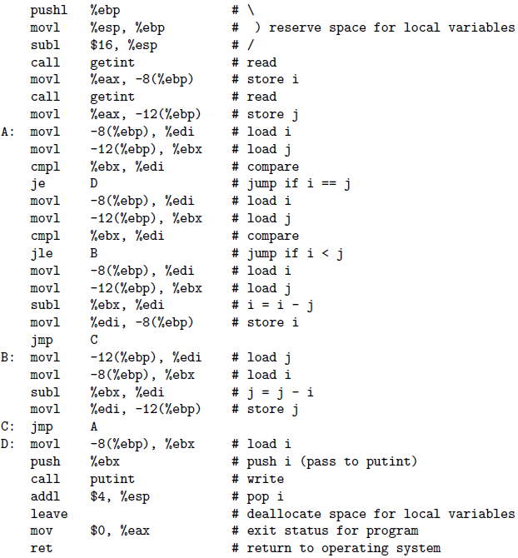
Assembler

